Slide 1
Automatic Document Summarization
——by Clarissa

Slide 2
Overview
Introduction
Sentence Extraction
Sentence Ordering
Other Interesting Approaches
Evaluation Methods
Closing Remarks

Slide 3
Overview
Introduction
Sentence Extraction
Sentence Ordering
Other Interesting Approaches
Evaluation Methods
Closing Remarks

Slide 4
Introduction
Definition
Classification
single-document or multi-document?
extraction-based or abstract-based?
query-relevant or generic?
An example

Slide 5
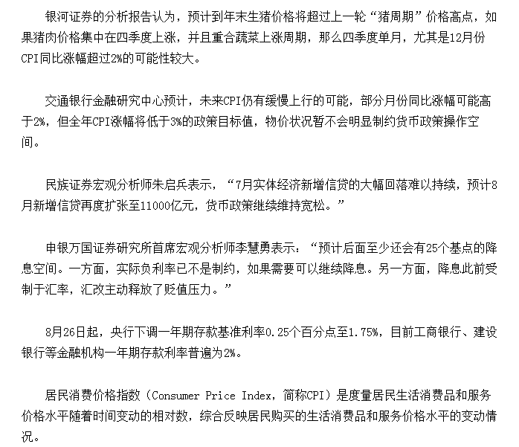
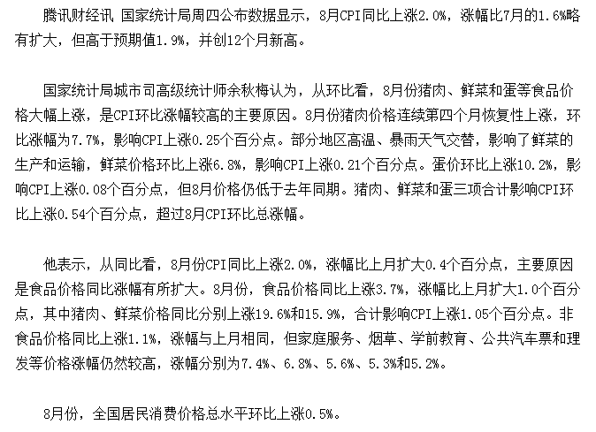

Slide 6
QUIZ
Name one classification I’ve mentioned before and explain it or just think of a new classification.

Slide 7
Overview
Introduction
Sentence Extraction
Sentence Ordering
Other Interesting Approaches
Evaluation Methods
Closing Remarks

Slide 8
Sentence Extraction
An iterative reinforcement approach
Graph-based Ranking approach
Sub-event based approach
Content Model based approach

Slide 9
An iterative reinforcement approach
Two assumptions:
Assumption 1: A sentence should be salient if it is heavily linked with other salient sentences, and a word should be salient if it is heavily linked with other salient words.
Assumption 2: A sentence should be salient if it contains many salient words, and a word should be salient if it appears in many salient sentences.
Three relationships:
SS-Relationship: computed by their content similarity (cosine measure).
WW-Relationship: computed by knowledge-based approach or corpus-based approach.
SW-Relationship: computed as the relative importance of a word in a sentence.

Slide 10
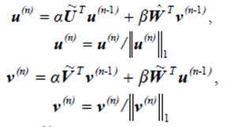
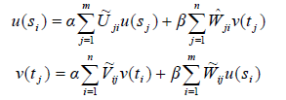
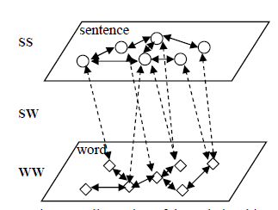
An iterative reinforcement approach
Steps:
Build three graphs to reflect SS, WW, SW relationships.
Computes the saliency scores of the sentences and words.
Use the reinforcement algorithm until it converges and each sentence gets a score.
Apply the MMR algorithm to remove redundancy.

Slide 11
An iterative reinforcement approach
Improvement?
WW relationship: Disambiguate the word sense before.
Single-document to Multi-document: Pick out content words.

Slide 12
Graph-based Ranking approach
Build a graph
Vertex: Every sentence
Edge : similarity relationship (overlap)
Ranking Algorithm:
1.HITS : For each vertex, HITS produces two sets of scores – an “authority” score, and a “hub” score.
2.PageRank: Integrates the impact of both incoming and outgoing links into one single model
3.TextRank: Include the weights factors

Slide 13


Graph-based Ranking approach
PageRank
G = (V;E) :a directed graph with the set of vertices V and set of edges E
For a given vertex Vi:
In(Vi) : the set of vertices that point to it (predecessors)
Out(Vi) : the set of vertices that vertex Vi points to(successors)

Slide 14
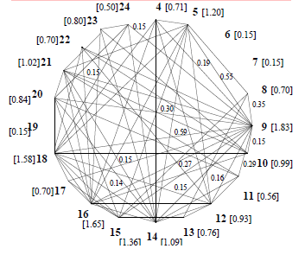
Graph-based Ranking approach
The final score is computed for each vertex

Slide 15
Graph-based Ranking approach
Improvement?
Single-document to Multi-document: consider about the sub-event and pick sentences purposefully.

Slide 16
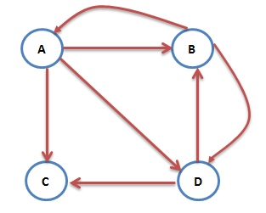
QUIZ
What’s the first iteration equation of the graph?(suppose d=0.85, the initial value for every PR(vi）is ¼, use the matrix)

Slide 17
Sub-event based approach
Basic Idea：Break documents down to their sub-events and capturing those sentences in each sub-event with the highest utility to produce a multi-document summary.
Two algorithms:
Sum of All Scores: best at 20% compression rate.
Lead-based: best at 10% compression rate.

Slide 18
Sub-event based approach
More:
Automatic Clustering(replace manual-classified sub-event): K-means
Similarity metric: Cosine Measure with IDF/ISF
How to seed?
for the first cluster, find the sentence which is closest to the centroid of the document cluster;
for each sentence after that, find the sentence which is maximally different from those sentences already picked as seeds

Slide 19
Sub-event based approach
Improvement?
Clustering method? (K-means creates K clusters)
Give the score of a sentence automatically while still considering its relationship with the sub-events?

Slide 20
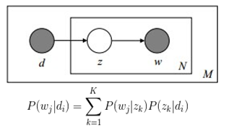

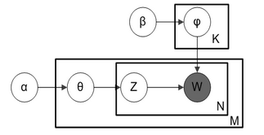
Content Model-based approach
PLSA Model
LDA Model
KLSum Formula
Find a set of summary sentences which closely match the document set unigram distribution

Slide 21
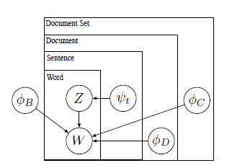
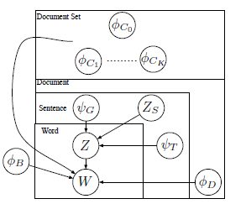
Content Model-based approach
Topic-Sum HIERSUM

Slide 22
Content Model-based approach
Improvement?
User-interested summarization?

Slide 23
Overview
Introduction
Sentence Extraction
Sentence Ordering
Other Interesting Approaches
Evaluation Methods
Closing Remarks

Slide 24
Sentence Ordering
Chronological Ordering(CO)
Majority Ordering (MO)
Probabilistic Ordering(PO)
Historical Ordering(HO)

Slide 25
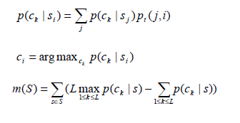
Historical Ordering
Sentence network construction
Construct a graph(a connected graph based on Jensen-Shannon divergence)
Assign a weight to each edge
Form a new manifold-based representation for each sentence ( a vector of conditional probabilities pt(si, sj) )
Sentence classification
Let S={(s1, c1), (s2, c2), …, (sL, cL), sL+1,…, sN}
Infer the labels for unlabeled sentences, sL+1,…, sN
Summary sentence ordering

Slide 26
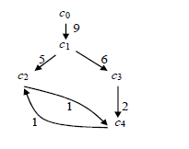
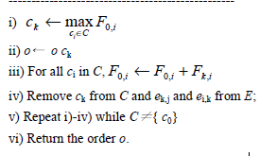
Historical Ordering
input : class graph G=<C, E>
C = {c1, c2, …, cL} :the set of the classes
E={ei,j|1≤i, j≤L} : the set of the directed edges(F: the weights)
o :the ordering of the classes

Slide 27
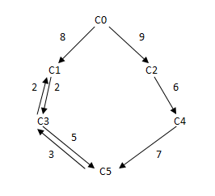
QUIZ
What’s the result of PO and HO strategy based on the following graph?

Slide 28
Overview
Introduction
Sentence Extraction
Sentence Ordering
Other Interesting Approaches
Evaluation Methods
Closing Remarks

Slide 29
Other Interesting Approaches
Query-relevant?
Steps:
1.Preprocess the query
extract the open-class words and NE from it
2.Use Wikipedia or WordNet to expand the extracted words.
3.Expansion filtering

Slide 30
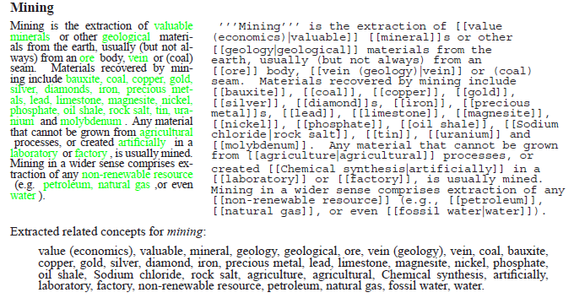

Slide 31
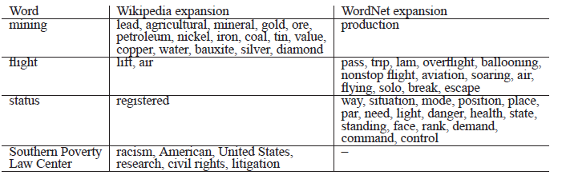

Slide 32
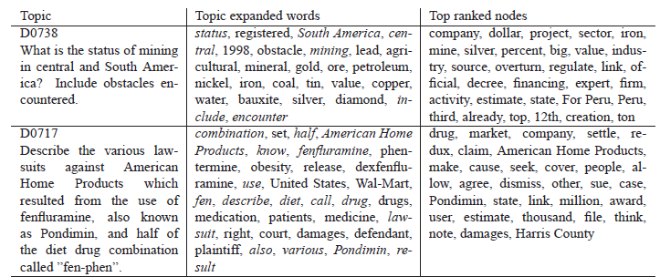
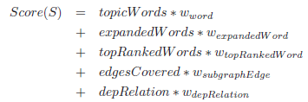
Other Interesting Approaches
Query-relevant?
Considering about the document set.
4.Spreading Activation
Build a graph based on the documents
Spread an activation signal starting from the topic words and expansions.
Traverse the graph and assign weights to the edges.
More related to topic expanded words, higher weights.
5.PageRank
Determine more important nodes(top ranked nodes) from the documents based graph.
6.Score the sentences

Slide 33
Other Interesting Approaches
Query-relevant?
Improvements?
The graph based on the documents: Cluster together related concepts(nodes)

Slide 34
Other Interesting Approaches
Word to sentence?

Slide 35
Overview
Introduction
Sentence Extraction
Sentence Ordering
Other Interesting Approach
Evaluation Methods
Closing Remarks

Slide 36
Evaluation Methods
Relative Utility (Manual)
Rouge (Automatic)
Measure the similarity between the automatic summary and the standard human-made summary.

Slide 37
Overview
Introduction
Sentence Extraction
Sentence Ordering
Other Interesting Approach
Evaluation Methods
Closing Remarks

Slide 38

Closing Remarks

Slide 39
The end.
Thanks~

